Slide 1
Object Oriented Programming Data Members (Constant, Static)
CS(217) Object Oriented Programming
Abeeda Akram

Slide 2
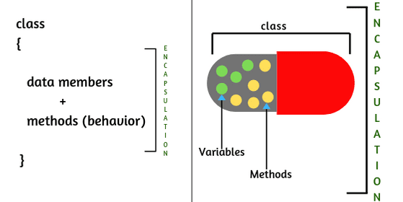
Class Data Members (TYPES)
Simple
Pointers Dynamic Memory
Constant
Static and Static Member functions

Slide 3
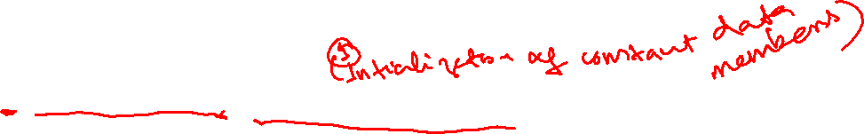
Data Members(Constant)
Does not change once initialized throughout life time of an object
Examples:
Student - Roll Number
Employee – ID
Point (fix axis) – X or Y (moves in line horizontal or vertical)
Initialization
With one fix value for all objects (initialize in class definition)
Different values for different objects (initialize in constructors)
Use Member initializer syntax
: Data member Name (value or variable or Expression)

Slide 4
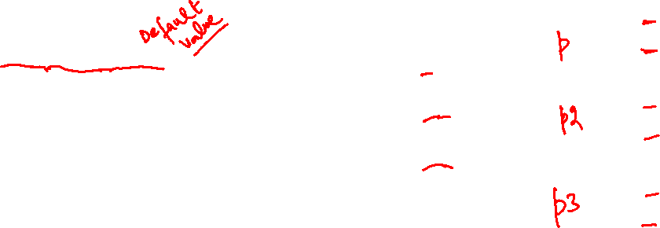
Data Members(Constant) Con..
With one fix value for all objects (initialize in class definition)
class Point {
int x;
const int y = 30;
};
X
y
void main(){
Point p;
Point p2;
Point p3;
}
?
30
X
y
?
30
X
y
?
30

Slide 5
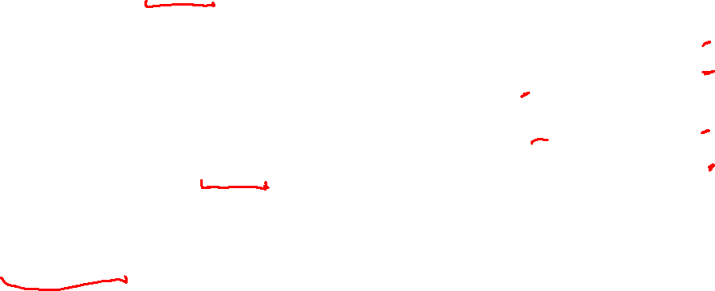
Data Members(Constant) Con..
With one fix value for all objects (initialize in class definition)
class Point {
int x;
const int y = 30;
public:
//Default constructor
Point();
//Parameterized constructors
Point(int x);
Point(int x, int y);
};
Point::Point(){ x = 0; y = 0;}
Point::Point(int x){ this->x = x;}
Point::Point(int x, int y){
this->x = x;
this->y = y;
}
X
y
0
0
void main(){
Point p;
Point p2(2);
Point p3(5,8);
}
//Compiler Error: cannot change the constant member using assignment once initialized
X
y
2
0
X
y
5
8

Slide 6
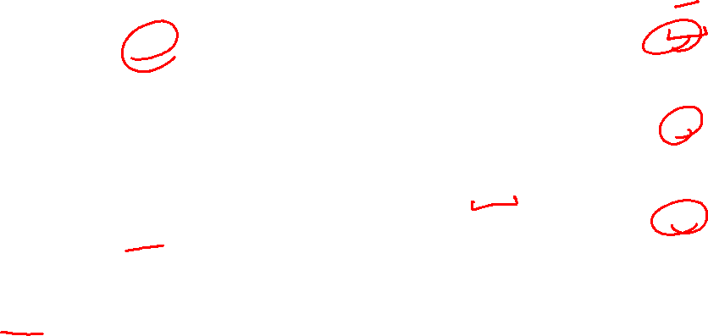
Data Members(Constant) Con..
With one fix value for all objects (initialize in class definition)
class Point {
int x;
const int y = 30;
public:
//Default constructor
Point();
//Parameterized constructors
Point(int x);
Point(int x, int y);
};
Point::Point(){ x = 0;}
Point::Point(int x){ this->x = x;}
Point::Point(int x, int y){
this->x = x;
}
X
y
0
30
void main(){
Point p;
Point p2(2);
Point p3(5,8);
}
//Same constant members data for all objects
X
y
2
30
X
y
5
30

Slide 7
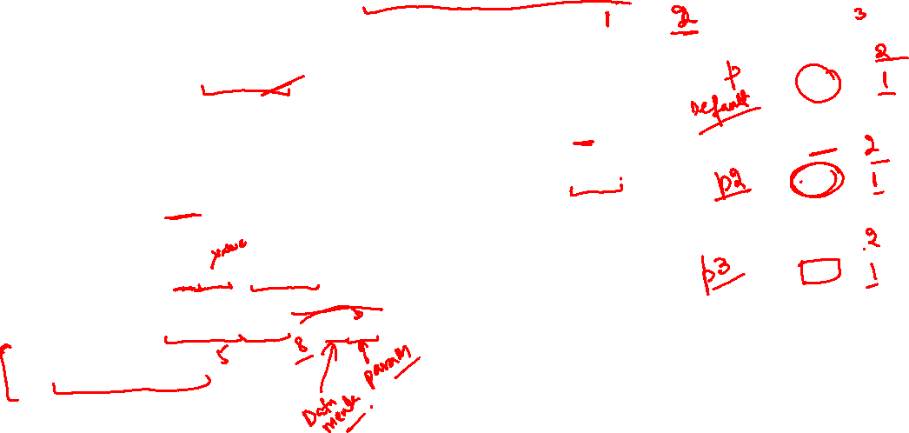
Data Members(Constant) Con..
Different values for different objects (initialize in constructors)
Use Member initializer syntax : Data member Name (value or variable or Expression)
class Point {
int x;
const int y = 30;
public:
//Default constructor
Point();
//Parameterized constructors
Point(int x);
Point(int x, int y);
};
Point::Point():y(0){ x = 0;}
Point::Point(int x){ this->x = x;}
Point::Point(int x, int y) :y(y)
{
this->x = x;
}
X
y
0
void main(){
Point p;
Point p2(2);
Point p3(5,8);
}
//Different constant members data for all objects
0
X
y
2
30
X
y
5
8

Slide 8
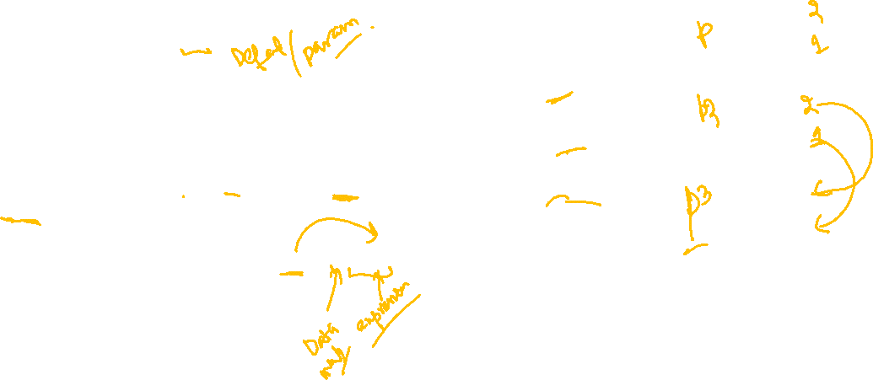
Data Members(Constant) Con..
Different values for different objects (initialize in constructors)
Use Member initializer syntax : Data member Name (value or variable or Expression)
class Point {
int x;
const int y;
public:
Point(int x = 0, int y = 0);
Point(const Point & p);
};
//Default and Parameterized
Point::Point(int x = 0, int y = 0) :y(y) { this->x = x;}
//Copy Constructor
Point::Point(const Point & p) :y(p.y)
if(this ! = &p)
this->x = p.x;
}
X
y
0
void main(){
Point p;
Point p2(5,8);
Point p3 = p2;
}
//Different constant members data for all objects
0
X
y
5
8
X
y
5
8

Slide 9
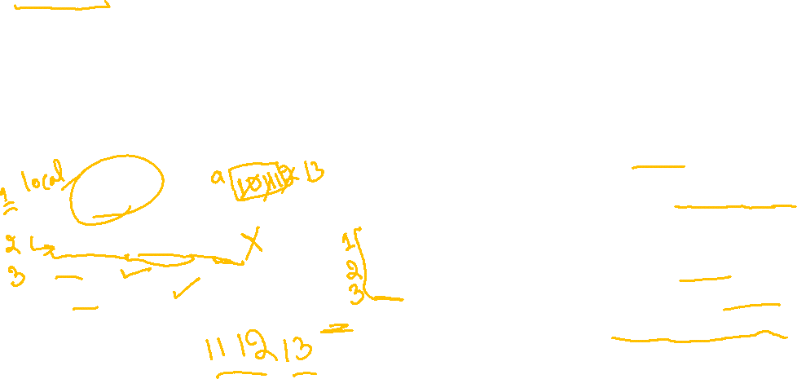
Static Variables
Special variables which Exist between function calls
Use Static (reserve word in C++) for creation
Life time
Starts when declaration statement executed
Ends when Main ends (Same as global variables)
Scope Local or global as normal variables
Used to track function level tasks for changing function behavior accordingly
void main()
{
fun();
fun();
fun();
}
void fun()
{
static int a = 10;
a++;
cout << a;
}
How many time function called?
Functions can communicate in future time with same functions.
Can Change behavior: Do one operation in first ten calls and then other for rest of calls.

Slide 10

Data Members (Static)
Have only one copy at class level
Their memory is allocated with class definition
Can be accessed without creating objects
Shared between all objects
All objects can read and write into that memory
Use: Objects can Communicate with one another using static members
Accessible
by name in all member functions as normal data members
through all objects as normal members using member access operator (.)
If declared public
Can be initialized and updated from outside the class
Also accessible at class level with scope resolution operator (::)

Slide 11
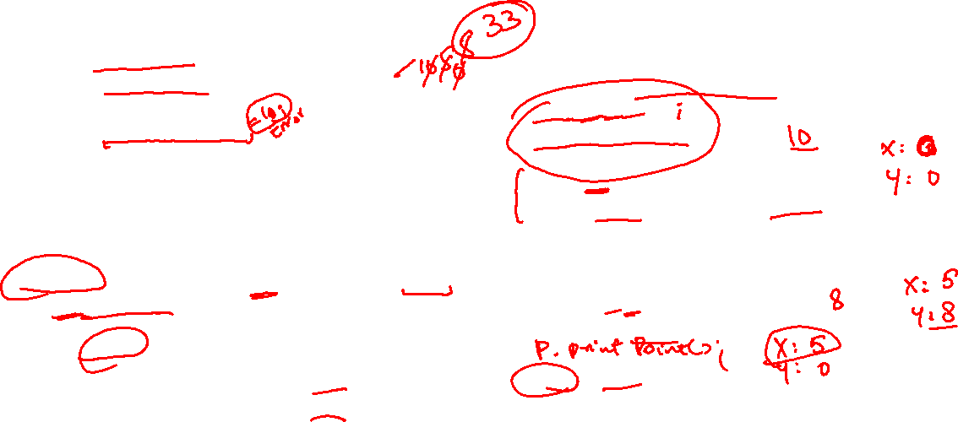
Data Members (Static) Con..
class Point {
const int y;
public:
static int x;
Point(int x = 0, int y = 0);
void printPoint() const;
};
// accessible as normal data members
Point::Point(int x = 0, int y = 0):y(y) {this->x = x;}
void Point::printPoint() const {
cout<< " X: " << this->x;
cout<< " Y: " << this->y;
}
void main(){
//Access at class level without object
Point::x = 10
cout << Point::x;
Point p;
p.printPoint();
//only non-static members become object property
Point p2(5,8);
p2.printPoint();
p2.x = 33;
//accessible as normal data members at object level
}
X
?
y
0
y
5

Slide 12
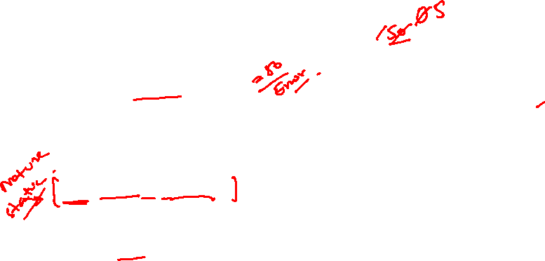
Data Members (Static) Con..
class Point {
const int y;
public:
static int x;
Point(int x = 0, int y = 0);
void printPoint() const;
};
//Can be initialized outside the class
int Point::x = 50;
Point::Point(int x = 0, int y = 0):y(y) {this->x = x;}
void Point::printPoint() const {
cout<< " X: " << this->x;
cout<< " Y: " << this->y;
}
void main(){
Point p;
p.printPoint();
Point p2(5,8);
p.printPoint();
}
X
?
y
0
y
5

Slide 13
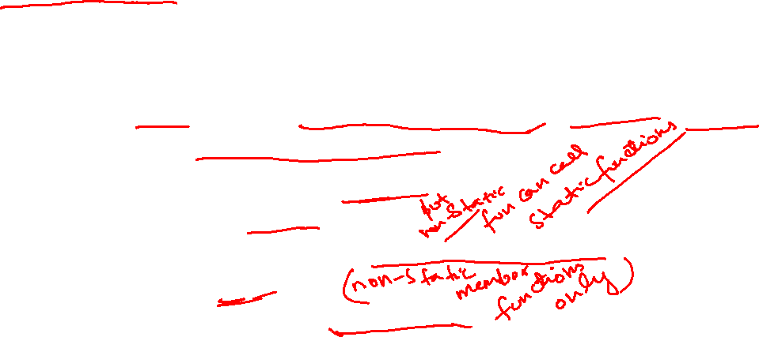
Static functions
Used to initialize and update private static members at class level
Can be invoked using
Class name and scope resolution operator (::) outside class (If declared public)
At object level like other member functions
Cannot access any thing at object level
Cannot call non-static functions
Cannot read or write into non-static data members
Do not have this pointer
Cannot be declared as const function.
Non Static functions can call static functions

Slide 14
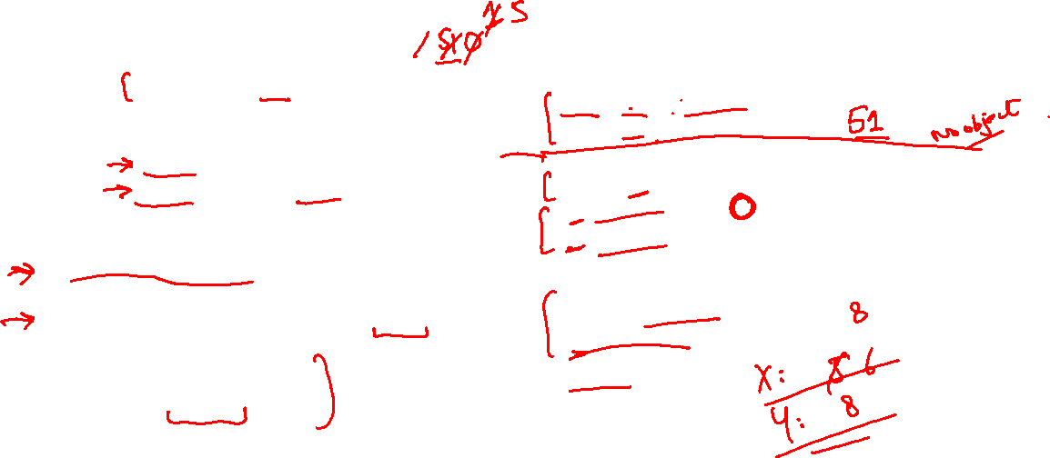
Data Members (Static) and Static functions
class Point {
const int y;
static int x;
public:
//static function
static void incrementX();
static void printX();
};
//Initialized outside the class
int Point::x = 50;
//Do not use static while definig
void Point::incrementX() { x++; }
void Point:: printX()
{ cout << Point::x; }
X
50
void main(){
Point:: incrementX();
Point:: printX();
Point p;
p.printX();
p.incrementX();
Point p2(5,8);
p.printPoint();
}
y
0
y
5

Slide 15
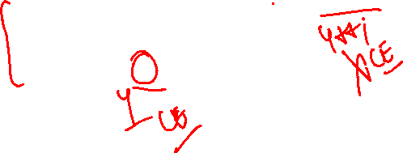
Data Members (Static) and Static functions
class Point {
const int y;
static int x;
public:
//static function
static void incrementX();
static void printX();
};
//Initialized outside the class
int Point::x = 50;
//Do not use static while definig
void Point::incrementX() { x++; }
void Point:: printX()
{ cout << x; }
X
50
void main(){
Point:: incrementX();
Point:: printX();
Point p;
p.printX();
p.incrementX();
Point p2(5,8);
p.printPoint();
}
y
0
y
5

Slide 16


































Slide 17







